Slide 1

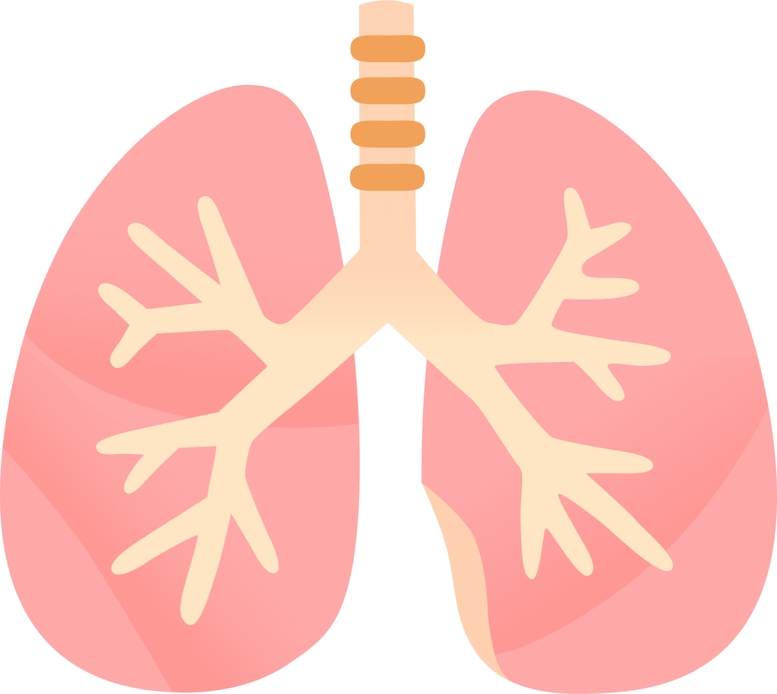
LUNG SOUND RECORDER
Team: Quad-Core Squad
By: Karthik, Aryanil, Anurag, and Adithya
Professor: Abhishek Srivastava
TA: Santhoshini
Week-5

Slide 2
New hardware setup

Slide 3
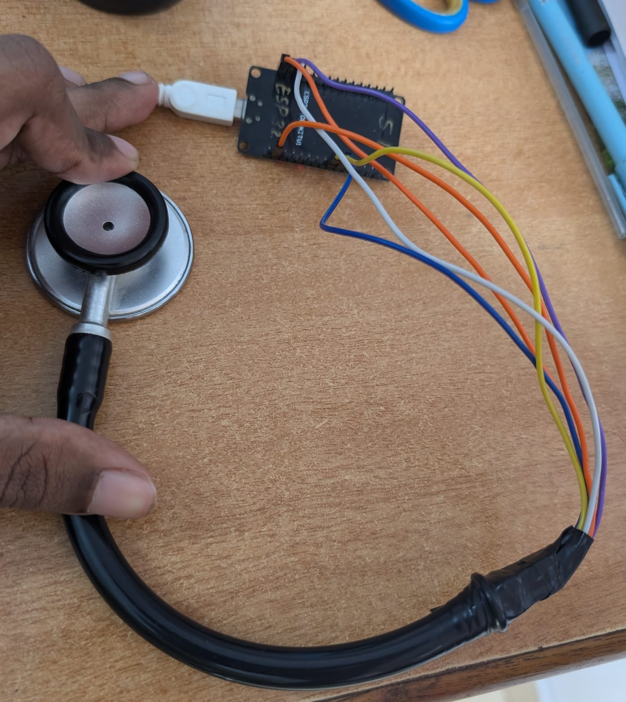
Setup
Added electrical tape to isolate outside noise
Tightly bound around both wires and INMP-stethoscope junction to completely cut out air flow
Cut stethoscope to ensure better sound receival
ESP32
Stethoscope head
Electrical tape
INMP441

Slide 4
Code Used
The code used for recording can be found at https://github.com/AryanilPanja/lung_sound_recorder/blob/main/mic_recording_github.ino

Slide 5
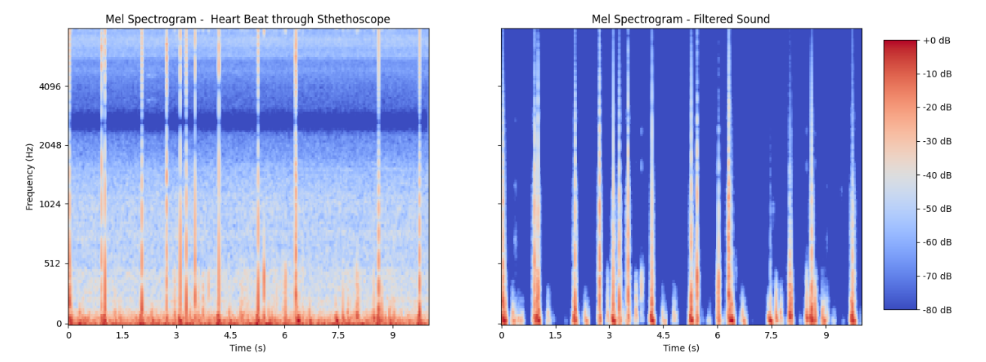
Recorded and filtered sound

Slide 6
Models

Slide 7
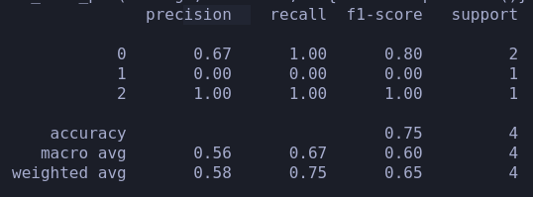
We ran an SVM Model
We took a dataset, labeled it accordingly and tried to run SVM. Dataset: https://data.mendeley.com/datasets/jwyy9np4gv/3

Slide 8
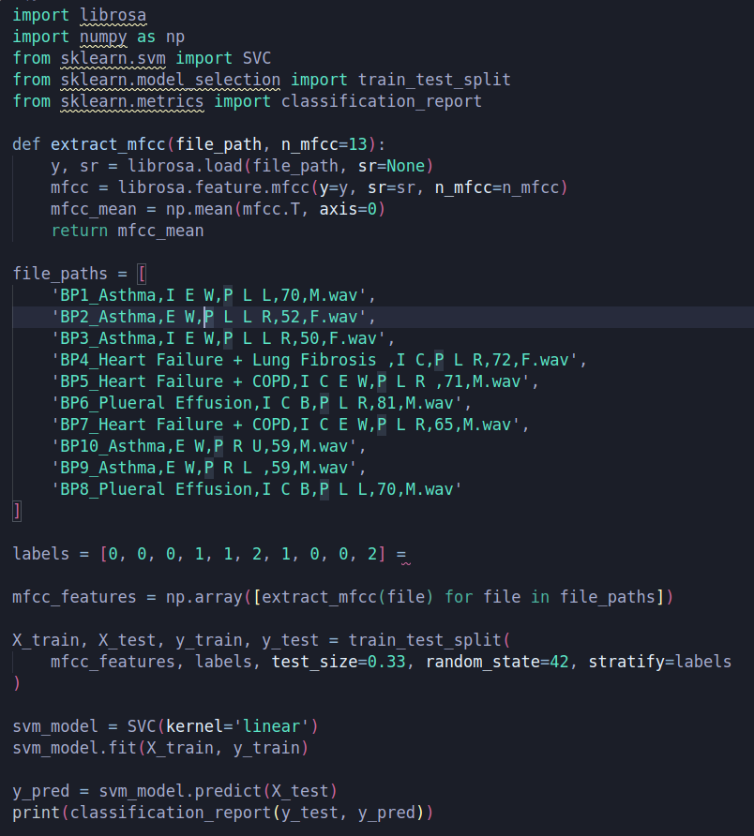
Code
Label 0 corresponds to asthma
Label 1 corresponds to heart failure
Label 2 corresponds to Pleural Effusion

Slide 9
Code References
https://medium.com/@davidfagb/understanding-the-support-vector-machine-svm-model-c8eb9bd54a97
https://www.ibm.com/docs/en/spss-modeler/18.4.0?topic=models-how-svm-works
https://www.analyticsvidhya.com/blog/2021/10/support-vector-machinessvm-a-complete-guide-for-beginners/

Slide 10
Reseach paper references
Data classification using support vector machine February 2010 Journal of Theoretical and Applied Information Technology Durgesh Srivastava and Lekha Bhambhu
Support Vector Machines: Theory and Applications September 2001Theodoros Evgeniou and Massimiliano Ponti

Slide 11
CNN model
We implemented the code for the CNN model and tried to train it on a small dataset with 3 subfolders(for heart failure, asthma, and pleural effusion).
We are loading the .wav files from the database and are preprocessing by extracting the Mel spectrograms.

Slide 12
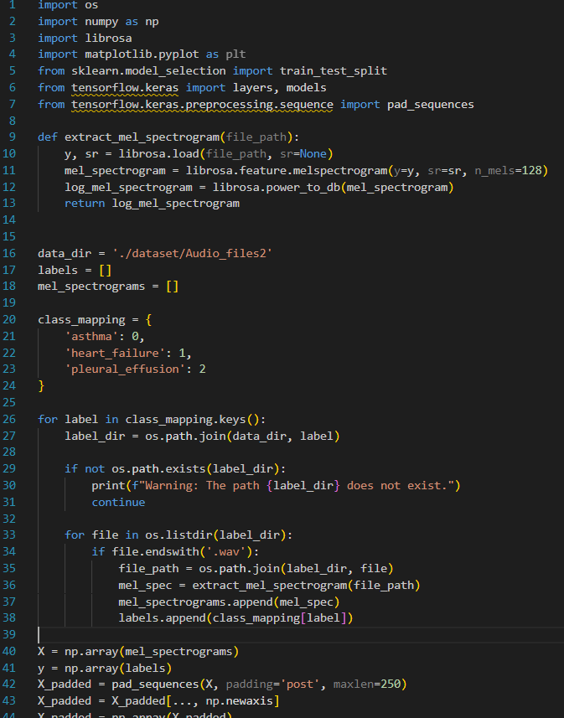
Code
The code for preprocessing (generating Mel spectrograms)

Slide 13
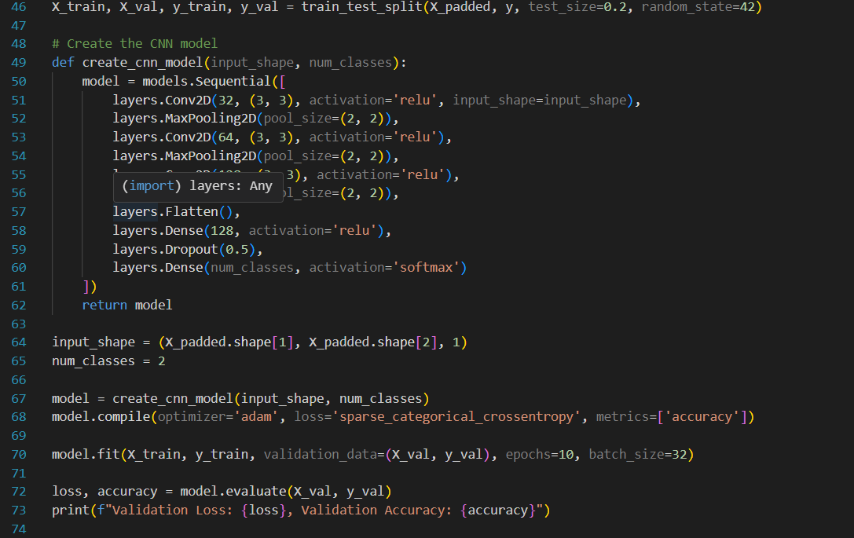
Code
The code for training the CNN model

Slide 14
References
https://www.kaggle.com/code/pavansanagapati/a-simple-cnn-model-beginner-guide
https://www.kaggle.com/code/nilshmeier/melspectrogram-based-cnn-classification

Slide 15
Long Short Term Model (LSTM) (or) Recurrent Neural Network (RNN)

Slide 16
I tried doing a sanity check on the model using ....
Imdb reviews and sin wave generator available by default in tensorflow.
(code on Github - https://github.com/AryanilPanja/lung_sound_recorder)

Slide 17
Next Steps
Generating more data points
Improving accuracy of models using data preprocessing and parameter tuning
Recording lung sounds

